Slide 1
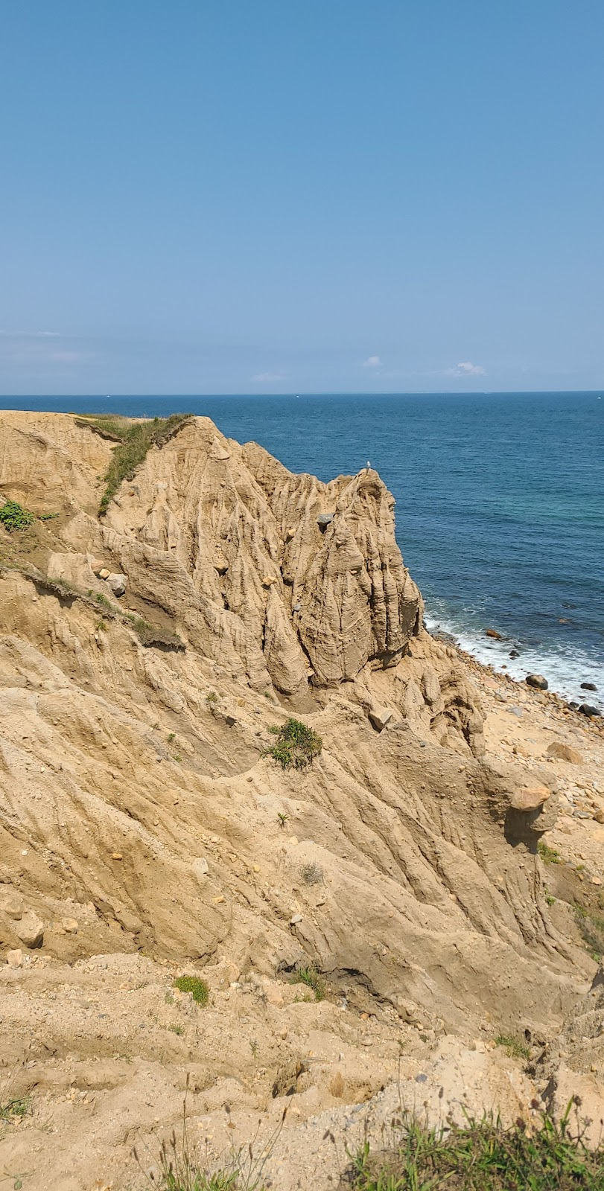
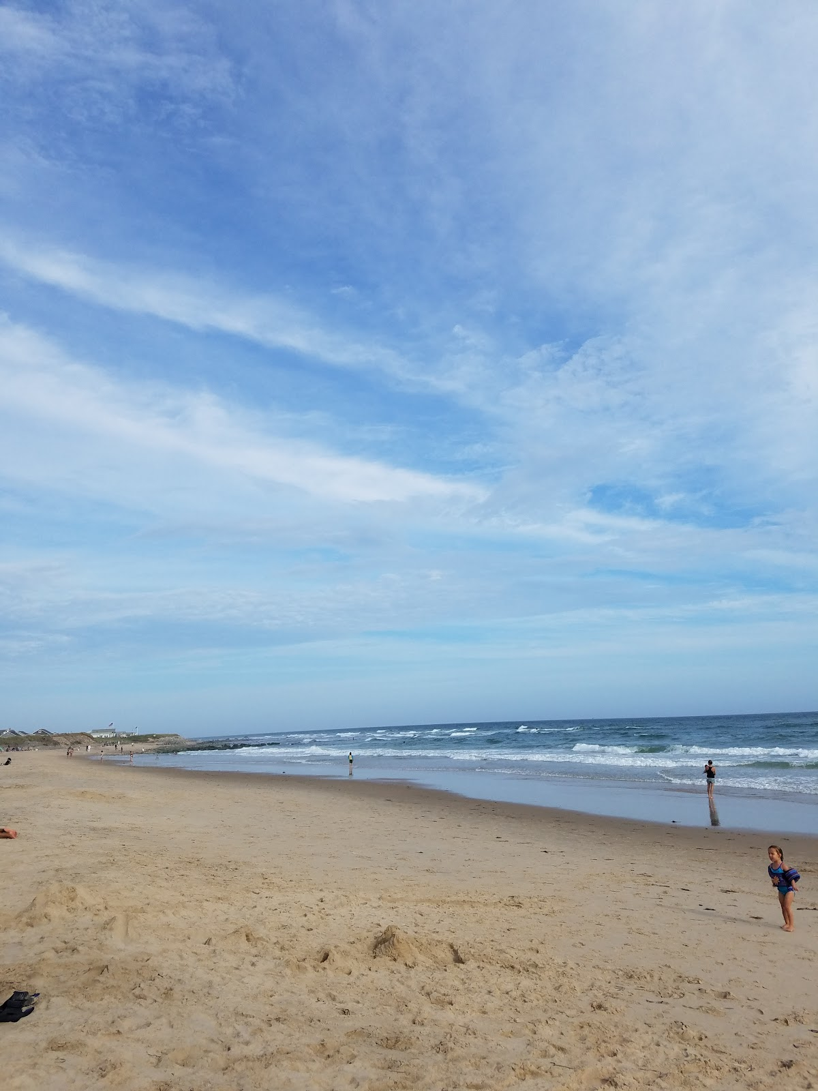
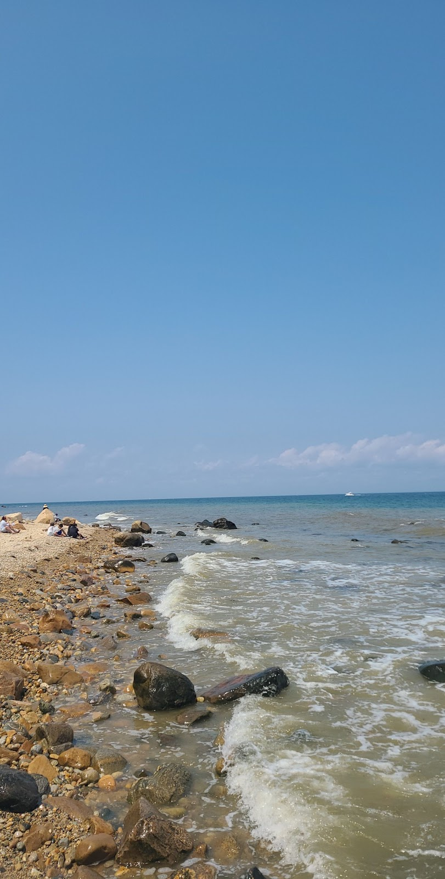
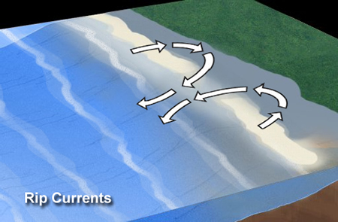
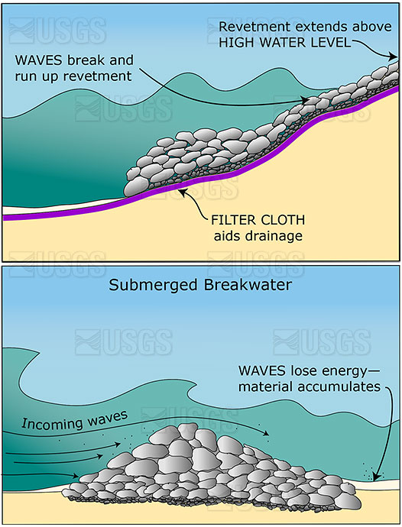
Rip Currents in Montauk
Causes
Presented by Peter Chang Seton Hall University
Solution
The Objective is to prevent erosion and rip currents from forming
My solution is to build underwater break waters to prevent further
What causes rip currents?
Waves travel from deep water to shallow water
As they break by the shore, strong currents develop.
When water flows fast in a narrow path, it can flow offshore pushing anything in its path out to sea
According to Amir Sharif Ahmadianm, Under water Breakwaters can provide:
Barriers to help disperse wave energy
Helps rebuild shores and sand collection
Hidden under water so helps keep natural landscape
Lower construction cost compared with other kinds of detached breakwaters
Effects
Rip currents can cause an increase in erosion due to fast currents and movements in the sand
Rip currents can create
Higher sand Bars
Deeper embayments in the sand
Increase strength in rip currents
stirs up sediment , causing visibility issues
More frequent rip currents' as eroded areas become Hotspots
Rip Currents - Currents_ NOAA's National Ocean Service Education.html
Changpet@shu.edu
USGS- Science-art.com

Slide 2
Work Cited
Rip currents could play role in increased coastal erosion. Life at OSU. (2017, October 5). Retrieved December 12, 2021, from https://today.oregonstate.edu/archives/2009/may/rip-currents-could-play-role-increased-coastal-erosion.
Submerged breakwater. Submerged Breakwater - an overview | ScienceDirect Topics. (n.d.). Retrieved December 7, 2021, from https://www.sciencedirect.com/topics/engineering/submerged-breakwater.
US Department of Commerce, N. O. and A. A. (2013, June 1). Rip currents. Currents: NOAA's National Ocean Service Education. Retrieved December 7, 2021, from https://oceanservice.noaa.gov/education/tutorial_currents/03coastal3.html#:~:text=When%20waves%20travel%20from%20deep,travels%20in%20an%20offshore%20direction.&text=Because%20rip%20currents%20move%20perpendicular,swimmers%20need%20to%20be%20careful.
National Geographic Society. (2012, November 9). Rip currents. National Geographic Society. Retrieved December 12, 2021, from https://www.nationalgeographic.org/media/rip-current-diagram/.
USGS- https://www.science-art.com/image/?id=7851&m=25397&pagename=Revetment_and_Submerged_Breakwater#.YlsOtOjMI2w

