Slide 1
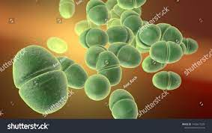
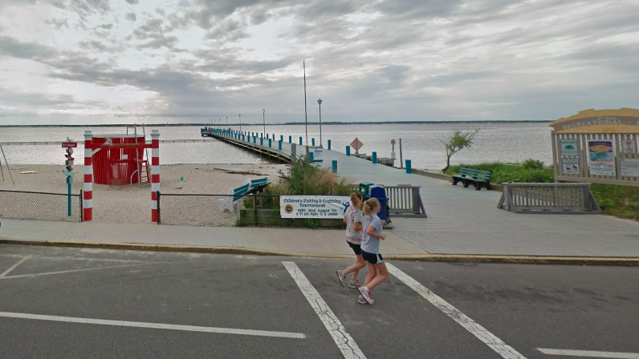
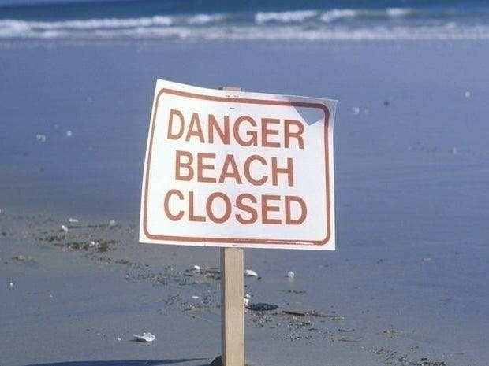
Bacteria in Water at Bay Front Beach
Cause & Effect
Possible Solutions
Causes:
Fecal matter excreted in ocean water
Pollution
Improper cleaning of beaches
Rising water temperatures associated with climate change
Effects
Enterococci (type of bacteria) levels were extremely high at 600 Enterococci/100 mL
12 recent beach closures
People experiencing symptoms of nausea, vomiting, diarrhea, abdominal pain, sore throat, cough, runny nose, sneezing, skin rashes, fever, and ear and eye irritation.
Testing increased to twice a day (one during the day and one at night) so see the levels of bacteria as the temperature changes Address concerns to local government officials to stoplight the issues of the water on this beach
Advocate for the government to give more money to helping the environment, specifically the NJ coast
Help stop pollution at the beach by organizing a community cleanup from 8:00 a.m. to 10:00 a.m. every Sunday morning
Continue monitoring temperature of the water to see how climate change plays a role in this situation at Seaside Borough – advice from a professional
BY: Lauren Best, Junior Finance and Marketing Student
The goal of this project is to create a sense of environmental awareness for those swimming in NJ oceans, specifically 5th Ave Bay Front Beach at Seaside Borough, and to find ways to implement change in this community in order to keep those swimming in the water safe. The dangers and health violations can pose as a great threat for individuals at these beaches, so this plan will effectively create solutions for Seaside Borough while explaining some of the causes which can be further prevented in the future. The result of this project along with the possibility of government planning could lead to less beach closures and less bacteria-related cases.
More about the Bacteria
Other NJ Beach Closures
Accepted level of Enterococci is 104 Enterococci/100 mL
Usually found in human intestines and the female genital tract
Caused 54,500 infections and 5,400 deaths in 2017
Can spread from contact with contaminated surfaces
Not spread through the air
Long Beach Twp Bay Beach: 4 exceedances
Surf City Bay Beach: 4 exceedances
Wildwood City Bennett Ave Beach: 3 exceedances
Lavallette Brooklyn Ave Bay Beach: 3 exceedances
Sea Isle City 34th St. Beach: 2 exceedances
Cape May City at Congress: 2 exceedances
Atlantic City at St. James: 1 exceedance
Long Beach Twp at Stockton: 1 exceedance

Slide 2
Sources
Alexander, D. (2021, July 14). NJ finds high bacteria levels at seaside, Point Pleasant Beaches. New Jersey 101.5. Retrieved November 16, 2021, from https://nj1015.com/nj-finds-high-bacteria-levels-at-seaside-point-pleasant-beaches/.
Bongard, K. (2021, August 26). 5 Ocean County Beaches Closed Due To High Fecal Bacteria. Berkeley, NJ Patch. https://patch.com/new-jersey/berkeley-nj/5-ocean-county-beaches-closed-due-high-fecal-bacteria
Enterococcus. (n.d.). [Photograph]. Enterococcus. https://en.wikipedia.org/wiki/Enterococcus
Leonard, J. (2017, July 12). What’s to know about Enterococcus faecalis? Medical News Today.
Shuttersrock 0 Open Access Image https://www.shutterstock.com/search/enterococcus
VRE in Healthcare Settings | HAI | CDC. (n.d.). CDC. Retrieved December 13, 2021, from https://www.cdc.gov/hai/organisms/vre/vre.html
Zoppo, A. (2021, July 2). Elevated bacteria levels were.htmlfound at these N.J. bay beaches last summer, report says. NJ. https://www.nj.com/ocean/2021/07/bacteria-closed-these-nj-bayside-beaches-for-35-days-last-summer

