Slide 1
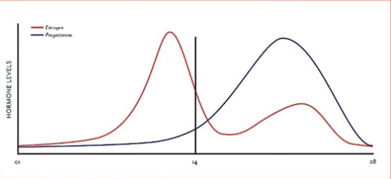
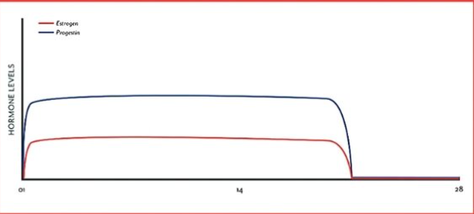
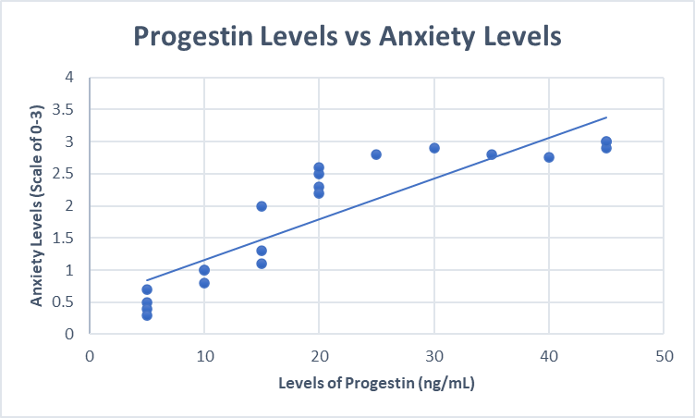
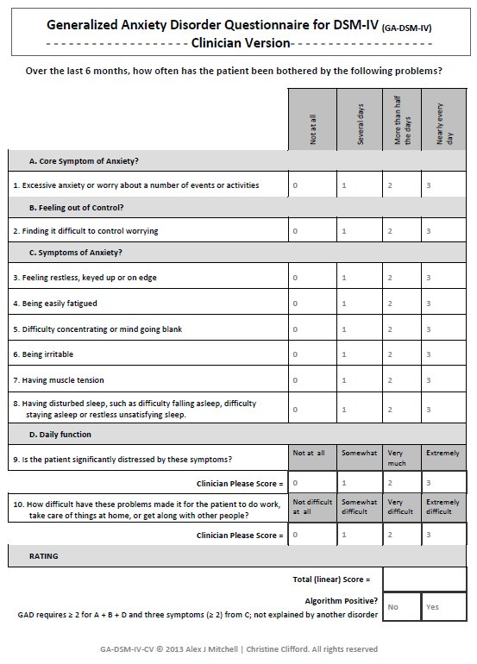
Effects of Progestin on Anxiety in Women Emily K. Forde, Hala H. Eshmawy, Jadeynne A. Hadley Department of Biological Sciences, College of Arts and Sciences, Seton Hall University
Abstract
Background and Significance
Progestin, a synthetic form of progesterone, is the common chemical component in birth control pills. Each brand of birth control may contain different concentrations of progestin which affect the progesterone level within the body. This leads to hormonal imbalance by replacing the natural form of progesterone because the receptors bind to the progestin chemical, instead of the progesterone. In our study, we will examine the affect of progestin on anxiety levels in women. Anxiety is a mental illness characterized by increased heart rate, excessive worrying, and trembling. We hypothesize that the women in the study who are taking the combination pill form of birth control will have higher levels of anxiety due to increased levels of progestin. We will be conducting a pilot, longitudinal study on 100 women over 5 years. These women will be the age of 18-30, not pregnant, and have non-interfering medical or familial history. 50 of the women will be on the combination pill form of birth control for at least 6 months and 50 of the women will be not taking birth control at the time of the study. We will begin by doing an intake on each woman that assesses their medical history, race, age, pregnancy history, trauma, and anxiety risk factors. We plan on surveying and conducting a blood test on each woman once every 3 months for the span of 5 years. The survey will assess overall anxiety levels on a scale from 0-3. Reported high levels of anxiety and the severity of mental illness across the population, specifically in young women, is rising significantly. This study will help discern the extent of synthetically induced hormones on mental illness and provide insight that can ideally be used in future studies to take preventative measures.
In a female, progesterone is synthesized and secreted in the ovaries, specifically the corpus luteum. To initiate the process, the FSH and LH are released from the pituitary gland, where they are then secreted into the bloodstream for travel to the corpus luteum. Within the corpus luteum, there are two cells known as the theca and granulosa cells. Since each of these cells contain LH, FSH, and LDL receptors; the LH binds to the theca cell receptor and the FSH binds to the granulosa cell receptor. Once the Theca cell accepts the LH via receptors, this connection allows the cell to increase its absorption of LDL cholesterol. With a high affinity, the LDL cholesterol is excreted from the bloodstream, and secreted into the theca cell. At this point, the cholesterol is used to synthesize the steroid hormone, progesterone. Once enzymes act on progesterone, the enzymes are used to create androgens. Since the theca cells lack the aromatase enzyme, the theca cells also lack the ability to produce progesterone on its own. As a result, the androgens diffuse through the basal membrane to the granulosa cell, where aromatase is present. With the presence of the enzyme aromatase, the androgens are converted into estrogen. After the estrogen is released into the bloodstream, ovulation occurs. In ovulation, the corpus luteum develops, allowing a network of cells to work together in order to form progesterone and estrogen. During this phase, the pituitary gland releases an additional amount of LH, which binds onto the granulosa cell receptor instead of the theca cell receptor. In order for this process to initiate, the basal membrane is breached, granting direct access from the blood vessels to the granulosa cell. At this point, the LDL cholesterol is excreted from the bloodstream, and secreted into the theca cell. Similar to the theca cell process, the cholesterol is then used to synthesize the steroid hormone, progesterone. Since the granulosa cell lacks additional enzymes to assist with the conversion from progesterone to androgens; the progesterone from both the theca and granulosa cells is secreted into the bloodstream. Essentially, our experiment aims to address the knowledge gap that is present regarding the effects of progestin on anxiety, specifically in women.
Preliminary Studies
Although few studies demonstrate the effect of synthetically induced hormone changes on mental illness, specifically anxiety, prior research has been performed to understand the relationship between hormones and mental illness. Progesterone and estrogen have been hypothesized extensively to impact depression and anxiety in women. The concept of progesterone behaving as a neuroprotectant could exhibit great benefits towards a woman’s mental health. However, the addition of Progestin decreases naturally produced progesterone, limiting natural neuroprotection. Various research studies performed on mice have provided sufficient basis regarding the great impact on a woman’s mental health following alteration to their natural hormone levels. One such study found that neurometabolites produced from progesterone were influenced by traumatic brain injury (TBI). Progesterone treatment in TBI decreased edema, inflammation, BBB dysfunction, and promoted survival of neurons and recovery (Guennoun, 2020). The literature relating neurological benefits of progesterone during a compromised state of TBI again furthers our question of whether the protective effects can impact the psychological nature of the brain rather than just the physiological, as we know how interconnected the two are. Similarly, an experiment performed on mice to surgically induce menopause by ovariectomy demonstrated that low concentrations of steroid hormones produce anxiety- and depression-like behavior (Rodriguez-Landa, 2020). These findings align with previous ideas that progesterone steroid hormone can be protective against anxiety and depression and therefore the removal of this hormone will cause adverse effects. One test performed to evaluate depressive and anxious behavior was the forced swim test. This test was used to evaluate mobility and lethargy, immobility was a sign of depressive behavior. 8 weeks after the rat’s ovaries were removed, the forced swim test showed more immobility. Regarding our theory of synthetically altered hormones, it is also mentioned that surgical menopause compared to natural menopause has different symptom implications. Another study that evaluates the association of hysterectomy with bipolar disorder risk demonstrated multiple concepts consistent with our hypothesis (Shen et al., 2019). It was depicted that in women, periods of natural hormone decline, such as pre-menstruation, postpartum, and perimenopause, demonstrate comorbidity with mood disorders. Levels of estradiol and progesterone typically increase during pregnancy but during the postpartum period, hormone levels drop abruptly, which may increase depression. The steep decline in estradiol levels associated with menopause may change the levels of neurotransmitters related to bipolar disorder which demonstrates the relationship between hormones and the nervous system. In another experiment, mice were treated with progesterone for 14 days after being separated from their mothers in order to induce a stress response. Maternal separation (MS) caused depressive behavior in the mice. These mice were then treated with progesterone. When they were treated, their behavioral tests proved that they were no longer exhibiting depressive behaviors. Progesterone’s several functions, including neuroprotection and its behavior as a neurosteroid aiding in stress responses, is emphasized by this study as well as those above.
Natural hormone cycle vs. Hormone cycle on birth control
Research Design and Methods
Acknowledgements
We will be conducting a 5-year longitudinal, pilot study on 100 women between the ages of 18 and 30. 50 of these women will be on the combination pill form of birth control for at least 6 months and the other 50 women will not be on birth control. An intake assessment will be done to ask the women questions regarding to their race, family history, medical history, mental health history, and risk factors. Throughout the 5 years, we will be conducted a survey and a blood test on each women every 3 months. The survey, used by the DSM-5, will assess anxiety levels on a quantitative scale of 0-3. The blood test will tell researchers the exact levels of progestin in the blood. With the combination of the survey and the blood work, the researchers will be able to compare levels of anxiety directly to levels of progestin.
Thank you do Dr. Zhou for being a mentor in this process.
Thank you for the women who will be surveyed.
Thank you to you all for listening!
References
“Coming off of Birth Control? Here's Your Guide to Preventing Side Effects of Stopping Birth Control Pills.” De Lune. https://www.delune.co/blogs/blog/coming-off-of-birth-control-here-s-your-guide-to-preventing-side-effects-of-stopping-birth-control-pills
Francisco Rodríguez-Landa, Juan, et al. “Actions of Progesterone on Depression-like Behavior in a Model of Surgical Menopause Are Mediated by GABAA Receptors.” Salud Mental, vol. 43, no. 1, Jan. 2020, pp. 43–53. EBSCOhost, https://doi.org/10.17711/SM.0185-3325.2020.007.
Guennoun, Rachida. “Progesterone in the Brain: Hormone, Neurosteroid and Neuroprotectant.” International Journal of Molecular Sciences, vol. 21, no. 15, July 2020. EBSCOhost, https://doi.org/10.3390/ijms21155271.
“Hormone Balancing for Young Women.” Hormone Balancing for Young Women – OC Integrative Medicine, https://oc-integrative-medicine.com/hormone-balancing-for-young-women/
Nouri, Ali, et al. “Progesterone Exerts Antidepressant-like Effect in a Mouse Model of Maternal Separation Stress through Mitigation of Neuroinflammatory Response and Oxidative Stress.” Pharmaceutical Biology, vol. 58, no. 1, Dec. 2020, pp. 64–71. EBSCOhost, https://doi.org/10.1080/13880209.2019.1702704.
Shen, Yu‐Chih, et al. “Association of Hysterectomy with Bipolar Disorder Risk: A Population-Based Cohort Study.” Depression & Anxiety (1091-4269), vol. 36, no. 6, June 2019, pp. 543–51. EBSCOhost, https://doi.org/10.1002/da.22904.
R. Guennoun. “Progesterone in the Brain: Hormone, Neurosteroid and Neuroprotectant.” International Journal of Molecular Sciences, U.S. National Library of Medicine, https://pubmed.ncbi.nlm.nih.gov/32722286/

