Slide 1
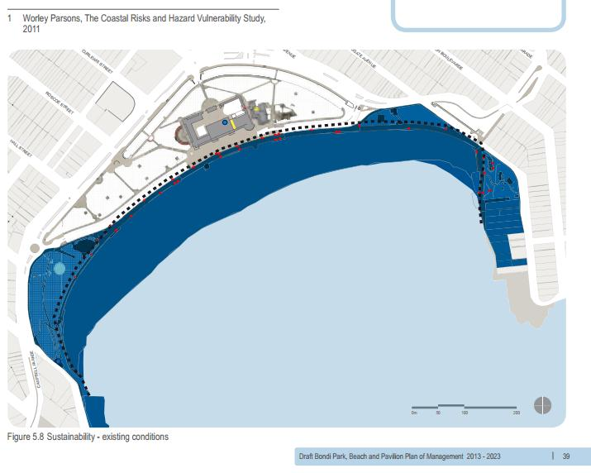
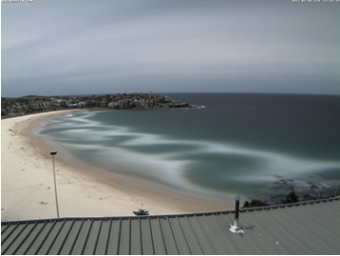
Bondi Beach: The Impact of Rip Currents and Beach Erosion
John C. Kelleher
Seton Hall University, South Orange, NJ 07079
Introduction:
Bondi Beach is a very popular beach located close to downtown Sydney. Although it is popular, rip currents are present every day and lead to many drownings of unaware beach goers each year. Rip currents occur because of beach erosion. How can beach erosion be controlled to limit the formation of rip currents and therefore save lives every year?
Causes of Rip Currents:
Rip currents form when there is a hole in a sandbar creating a channel for backwash to flow out to sea.
Beach erosion is the primary reason for rip currents to continue to form.
When more holes form in a sandbar overtime, more rip currents form. (See Diagram 2: white portion are rip current flows over a 30-minute period).
Solutions:
A seawall has already been placed on Bondi Beach to protect the businesses and area behind Bondi Beach.
Increasing the amount of sand on the beach would be a wise investment and could provide a short-term solution. Unfortunately, more rip currents may occur, as seen in Delray, FL.
Educating beach-goers (using signs and videos) about how to spot rip currents and what to do if you are caught in one will help to save lives.
An artificial reef could be off the Bondi coast in order to create a stable sand bar , reduce the incoming wave energy, and limit the amount of rip currents in the near future.
Long-term, our habits contribute to climate change, which leads to rising sea levels. This will eventually submerge Bondi, along with many other popular beaches.
Short Term Effects of Rip Currents:
Rip currents cause around 21 drownings each year according to Coastal Safety Brief of 2019.
Rip currents can lead to more deaths, because others may try to rescue victims of a rip current.
Rip currents may cause a drop in tourism if people are aware of their dangers and avoid the beach.
Long-term effects of Beach Erosion:
Bondi Beach could be completely flooded by 2100 because of sea level rise and the increase in climate change. (Diagram 1 shows expectation of flooding, dark blue is the flooded area)
The businesses and housing market around Bondi Beach could suffer because of a lack of tourism and interest in living near Bondi Beach.
The Coastal Risk and Hazard Vulnerability Study [Digital image]. (2013, September 30). Retrieved December 5, 2020, from https://davidshoebridge.org.au/2013/09/30/where-did-bondi-beach-go-dont-ask-a-liberal-council-with-its-head-in-the-sand/
Bondi Beach [Photograph found in Sydney, AU]. (n.d.). Retrieved December 5, 2020, from https://www.scienceofthesurf.com/ripom.html (Originally photographed 2012, March 3)
Conclusion:
Rip currents are difficult to control, but providing the proper signs are crucial in informing beach goers of the dangers that go with rip currents.
Bondi Beach installed a seawall to protect the community from storm surge flooding
Email Address: john.kelleher@student.shu.edu

Slide 2
Works Cited
Church, J. (2020, March 03). The world may lose half its sandy beaches by 2100. It's not too late to save them. Retrieved November 5, 2020, from https://newsroom.unsw.edu.au/news/science-tech/world-may-lose-half-its-sandy-beaches-2100-it’s-not-too-late-save-them
Fletemeyer, J., Hearin, J., Haus, B., & Sullivan, A. (2018). The Impact of Sand Nourishment on Beach Safety. Journal of Coastal Research, 34(1), 1-5. Retrieved December 4, 2020, from http://www.jstor.org/stable/26296438
Gooch, D., & Nielson, L. (2011, December). Waverley Coastal Risks and Hazards Vulnerability Study [PDF]. Sydney, AU: WorleyParsons.
National Geographic Society. (2012, October 09). Rip current. Retrieved December 4, 2020, from https://www.nationalgeographic.org/encyclopedia/rip-current/
Slsa, & Surflifesavingaustralia. (n.d.). Coastal Safety Brief - Rip Currents 2019. Retrieved November 5, 2020, from https://issuu.com/surflifesavingaustralia/docs/csb_rips_brief_web

